Slide 1
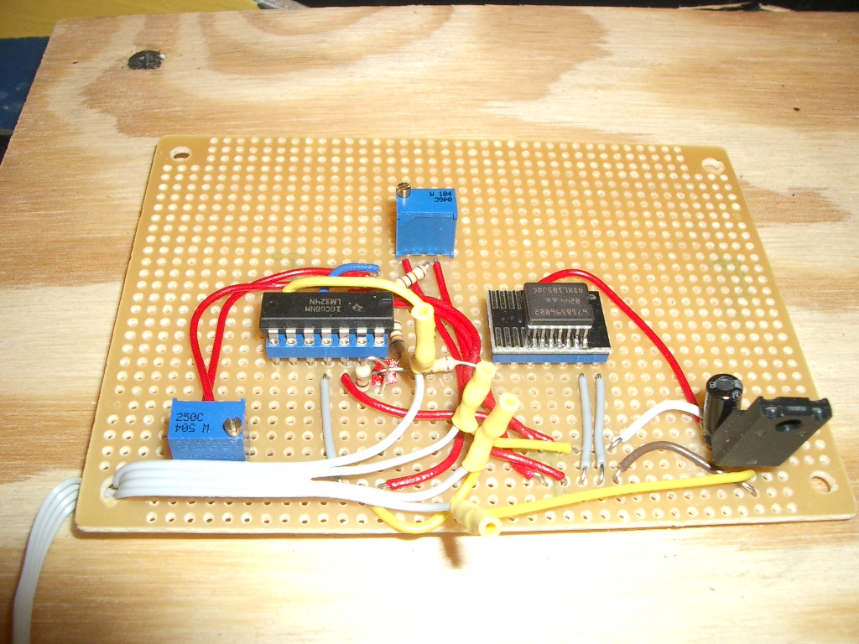
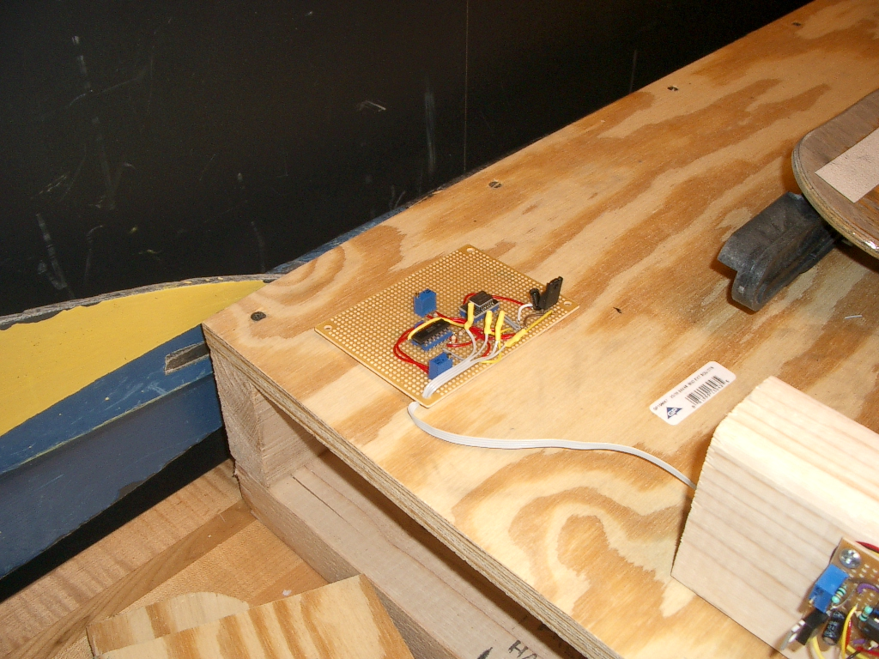
Trial 1 – Successful – Shell Acceleration Sensor
Initially using the Accelerometer circuits as tilt sensors, they were too noisy.
We recalibrated one of the accelerometer sensors to measure the acceleration of the crew shell while in motion, works well.
Accelerometer Circuit
ENCL-10

